Slide 1

INTRO TO
PYTHON
Section Three

Slide 2
Loops in Python
[For, While and Nested Loops]
Python programming language provides two types of loops – For loop and While loop to handle looping requirements. Python provides three ways for executing the loops.
While all the ways provide similar basic functionality, they differ in their syntax and condition-checking time. In this section, we will look at Python loops and understand their working with the help of examples.

Slide 3
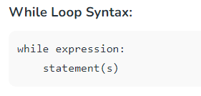
While Loop in Python
In Python, a while loop is used to execute a block of statements repeatedly until a given condition is satisfied. When the condition becomes false, the line immediately after the loop in the program is executed.

Slide 4
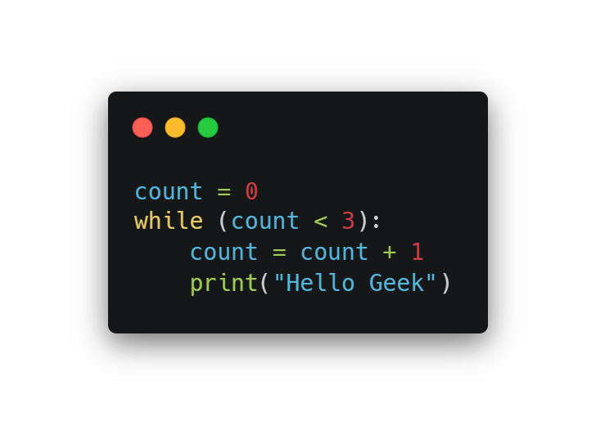
Example of Python While Loop
All the statements indented by the same number of character spaces after a programming construct are considered to be part of a single block of code. Python uses indentation as its method of grouping statements.

Slide 5
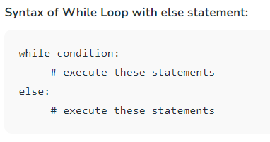
Using else with While Loop
The else clause is only executed when your while condition becomes false. If you break out of the loop, or if an exception is raised, it won’t be executed.

Slide 6
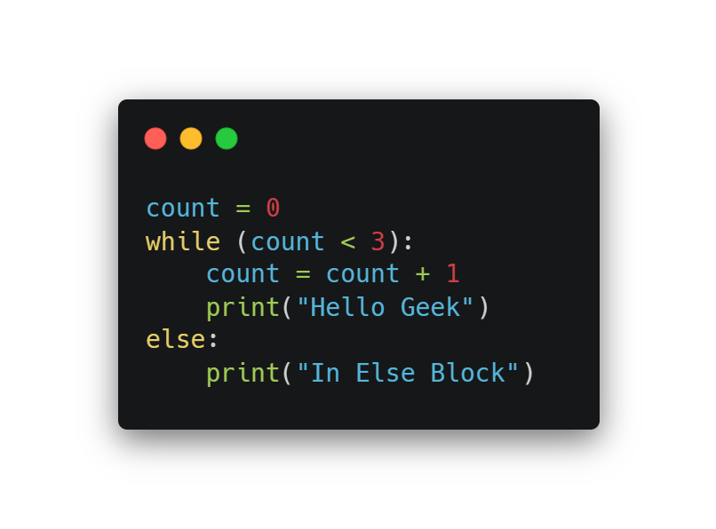
Examples of While Loop with else statement:
The code prints “Hello Geek” three times using a ‘while' loop and then, after the loop, it prints “In Else Block” because there is an “else” block associated with the ‘while' loop.

Slide 7
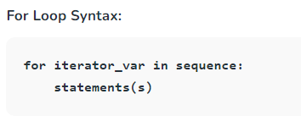
For Loop in Python
For loops are used for sequential traversal. For example: traversing a list or string or array etc. In Python, there is “for in” loop which is similar to foreach loop in other languages. Let us learn how to use for loop in Python for sequential traversals with examples.

Slide 8
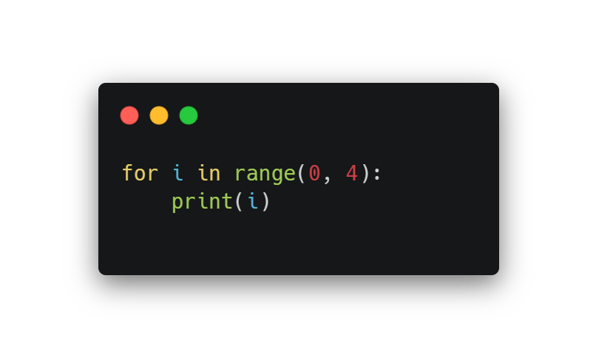
Example:
The code uses a Python for loop that iterates over the values from 0 to 3 (not including 4), as specified by the range(0, n) construct. It will print the values of ‘i' in each iteration of the loop.

Slide 9
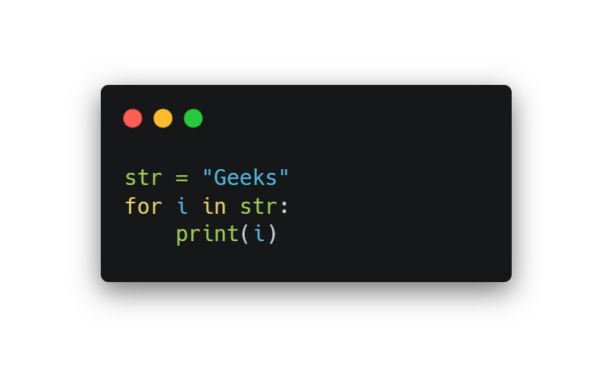
String Iteration Using for Loops
We can use for loop to iterate lists, tuples, strings and dictionaries in Python.

Slide 10
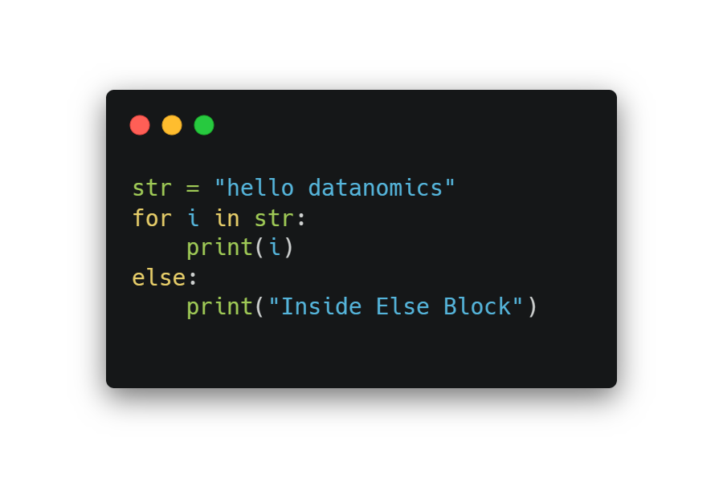
else Statement with for Loop
We can also combine else statement with for loop like in while loop. But as there is no condition in for loop based on which the execution will terminate so the else block will be executed immediately after for block finishes execution.

Slide 11
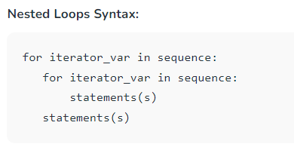
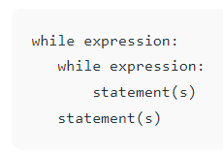
Nested Loops
Python programming language allows to use one loop inside another loop which is called nested loop.
A final note on loop nesting is that we can put any type of loop inside of any other type of loop. For example, a for loop can be inside a while loop or vice versa.

Slide 12
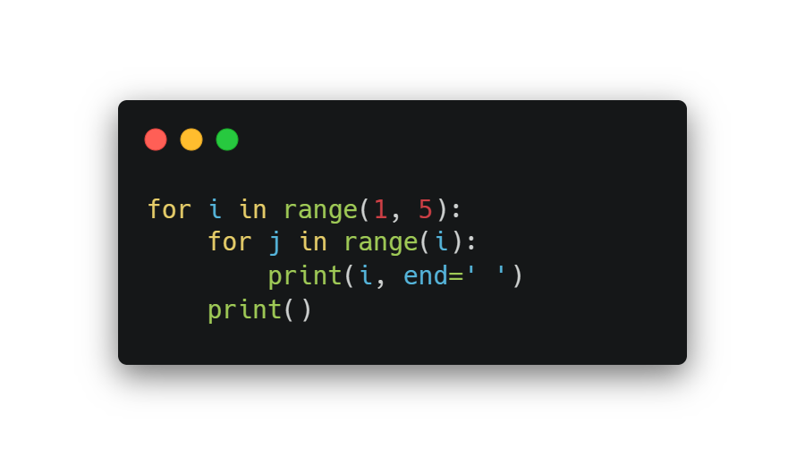
Nested loop example

Slide 13
Loop Control Statements
Loop control statements change execution from their normal sequence. When execution leaves a scope, all automatic objects that were created in that scope are destroyed. Python supports the following control statements.
Continue - Break - Pass

Slide 14
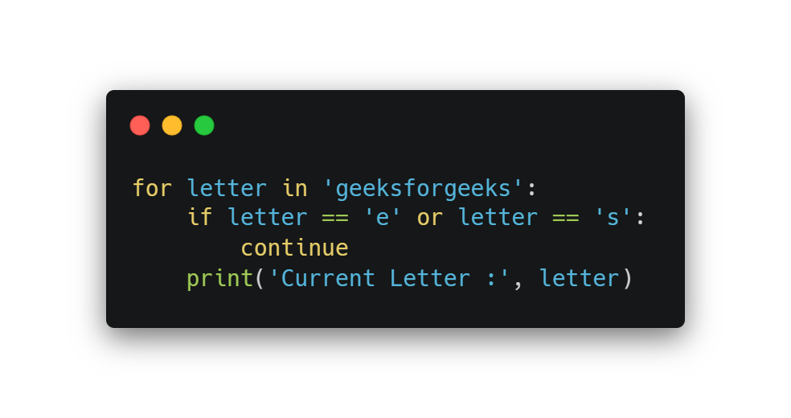
Loop Control [continue]
The continue statement in Python returns the control to the beginning of the loop.
Example:
This Python code iterates through the characters of the string ‘geeksforgeeks’. When it encounters the characters ‘e’ or ‘s’, it uses the continue statement to skip the current iteration and continue with the next character. For all other characters, it prints “Current Letter :” followed by the character. So, the output will display all characters except ‘e’ and ‘s’, each on a separate line.

Slide 15
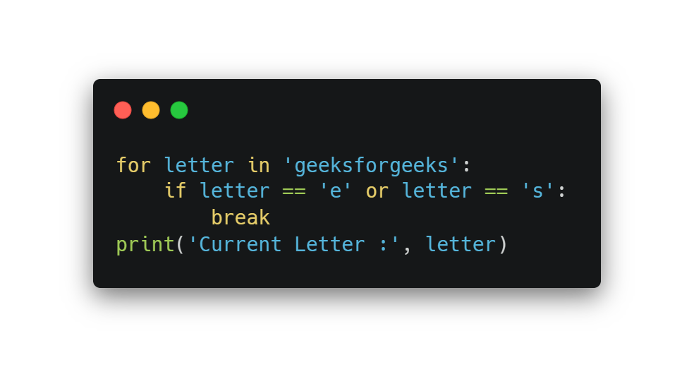
Loop Control [break]
The break statement in Python brings control out of the loop.
Example: In this Python code, it iterates through the characters of the string ‘geeksforgeeks’. When it encounters the characters ‘e’ or ‘s’, it uses the break statement to exit the loop. After the loop is terminated, it prints “Current Letter :” followed by the last character encountered in the loop (either ‘e’ or ‘s’). So, the output will display “Current Letter :” followed by the first occurrence of ‘e’ or ‘s’ in the string.

Slide 16
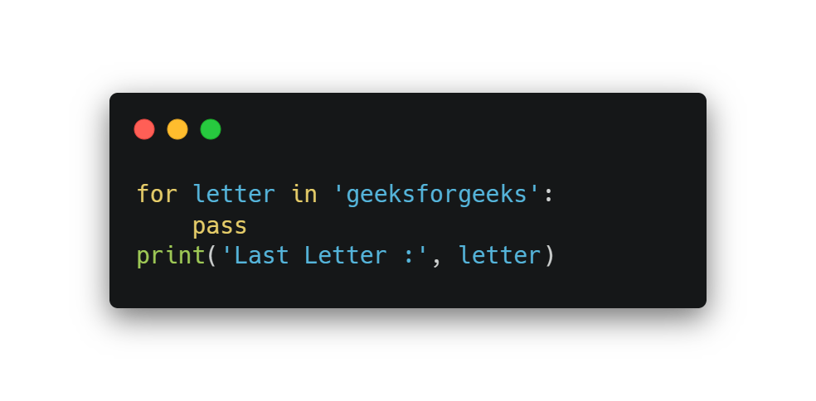
Loop Control [pass]
We use pass statement in Python to write empty loops
Example: This Python code iterates through the characters of the string ‘geeksforgeeks’ using a ‘for' loop. However, it doesn’t perform any specific action within the loop, and the ‘pass' statement is used. After the loop, it prints “Last Letter :” followed by the last character in the string, which is ‘s’.

Slide 17
Presentation Assignment
Prepare a presentation for the next class about
  Application of loops
  Difference between for and while loop
  What is do-while? how does it work? one code example based on what you mentioned as application in question number one.

